Slide 1

Week 24/02/2023

Slide 2
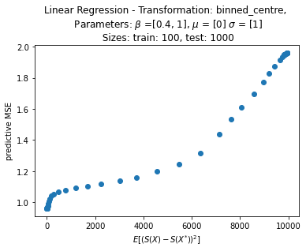
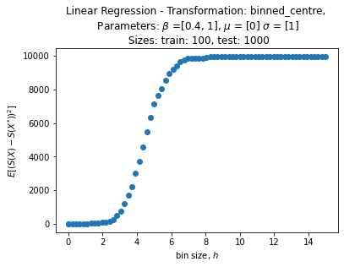
Univariate linear regression

Slide 3
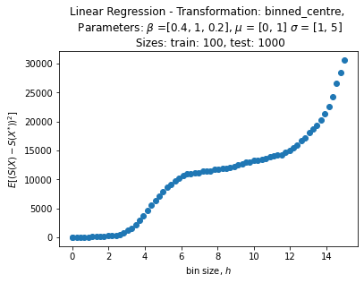
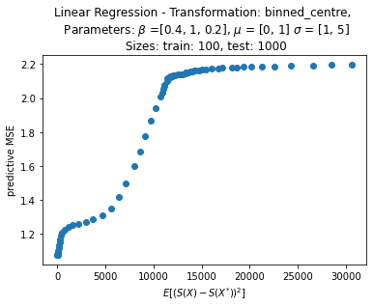
Extension to multivariate linear regression
BIVARIATE

Slide 4
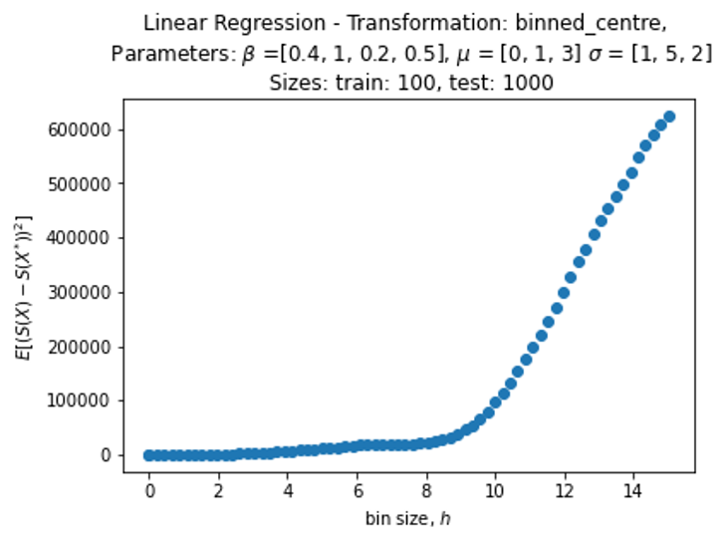
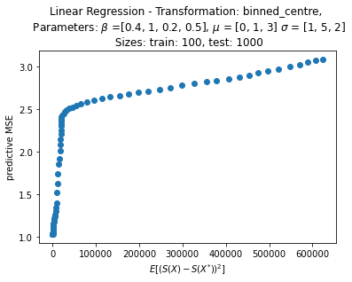
Extension to multivariate linear regression
3 DIMENSIONS

Slide 5
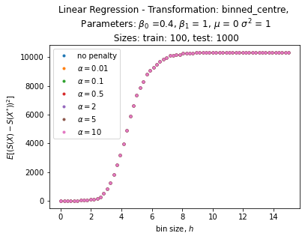
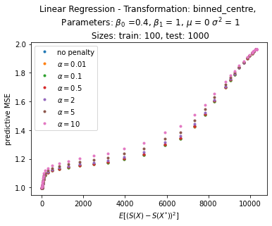
LINear regression
VARIOUS L2 PENALTIES

Slide 6
Theoretical statistics
Result in Book

